Slide 1
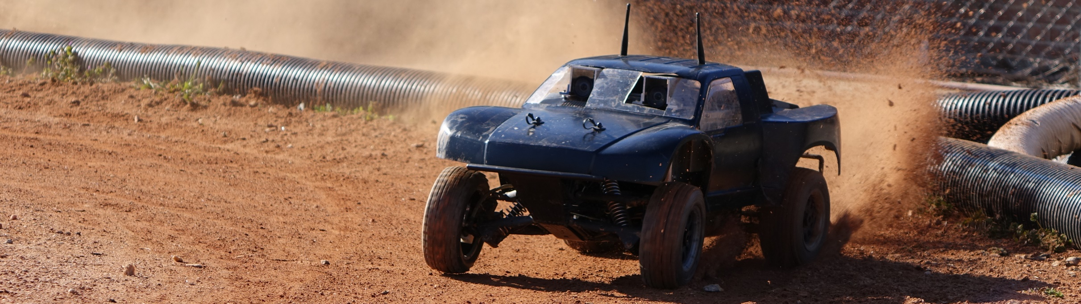
Autonomous RC (ARC)
Cierra Shawe, Tao Chen, Daniel Stoyer
Figure 1
Figure 1: image from https://autorally.github.io/
Notes:
Depends on how intelligent our system is: like a human driving a car doesn’t need to understand the steering ratio of the car. If the turning angle is too small, a human would just apply more steering. That requires a more sophisticated system.

Slide 2
Introduction
What ARC is all about!

Slide 3
Introduction
The purpose of the Autonomous RC (ARC) project is to determine if it is possible to build an autonomous RC vehicle using commodity components, meaning components that are relatively inexpensive and can be bought at places like Radio Shack®, Best Buy®, or on Amazon®.

Slide 4
Introduction
Our goal is to make an RC vehicle navigate autonomous to a given waypoint/location, preferably at a high rate of speed. Stretch goals are to make the vehicle drift around corners and parallel park.

Slide 5
Overview of Design
Our approach to the ARC design

Slide 6
Overview of Design
Experimental model using milestones: The uncertain nature of the ARC project requires us to set capability milestones to measure against.
Milestone #1: All hardware and communications between hardware are ready.
Milestone #2: Hardware mounting is completed and tested.
Milestone #3: Operations in a local setup are completed and tested.
Milestone #4: Operations in a global setup are completed and tested.
Milestone #5: Stretch goals are completed and tested.
Notes:
1: We are still on the fence about what hardware we are going to use for some components of the project. We need to confirm every single piece of hardware before we can start our implementation. (Electronic hardware: computers, sensors, wires, etc. Basically everything that is part of the software.) We also need to make sure that the communications between the hardware are ready to go, both in hardware and software.
This process could take 1 to 2 weeks. Plan: take this down during winter break.
2: After we have had all the necessary electronic components, we should start considering the safest way to mount the hardware.
This could take 2 to 3 weeks, including, design, 3D printing, assembling, and testing. Plan: finish during the break or in the first two weeks of winter term.
3: After the vehicle is fully operational without any autonomous features, we move to a phase where we will implement the software for local operations. Meanwhile, the outcomes from milestone 1 and 2 will be tested more thoroughly. This phase will take 3 to 4 weeks. Will be done in winter term.
4: Global operations. Could possibly reuse some of the work done in milestone 3. this phase will take 3 to 4 weeks as well. Meanwhile, revise milestone 1, 2, 3.
5: Stretch goals: (Drifting and parallel parking) Do our best to accomplish these goals. Will take the rest of the time until Expo. This phase acts as a buffer to work on any unfinished tasks in milestone 3, 4.

Slide 7
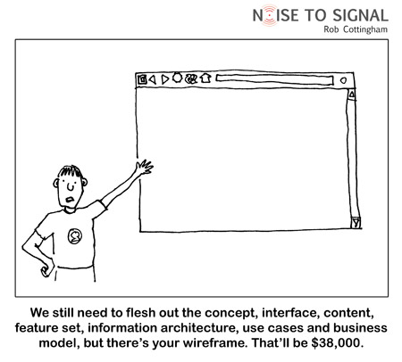
Current State of ARC
Figure 2
Figure 2: image from http://digitalsynopsis.com/wp-content/uploads/2015/03/web-designer-developer-jokes-humour-funny-12.jpg

Slide 8
Just kidding!
Here is where we are at …

Slide 9
Activities Summary
A summary of weekly activities, problems, and solutions.

Slide 10
Weeks 1-2
Weeks one and two were general introduction and orientation weeks. It was not until week 3 that projects started in earnest and the first assignment was assigned.

Slide 11
Week 3
Activities: Worked on creating the problem statement. This required getting an overall understanding of what our autonomous RC vehicle should be able to do. In other words, getting on paper the expectations of our client for the final product. We also started researching what we would need for the SRS document, both in terms of the ARC project and in terms of the LaTeX document. We needed a Gantt chart for the SRS, so we started researching how to do that.

Slide 12
Week 3
Problems: Our client was ill during this time, so feedback for the problem statement was understandably delayed. We struggled a little with using the proper tense in the document and getting a high-enough, yet detailed enough written view of the ARC project. We needed clarification on details for the expected vehicle capabilities.

Slide 13
Week 3
Solutions: We talked with our client on how to frame our project appropriately. For the vehicle capabilities, our client told us to aim high, if we need to scale things back later we will.

Slide 14
Week 4
Activities: Received feedback on our problem statement and made required changes. We needed to clarify what our motivation for the project was, namely that we are trying to create an autonomous RC system that is considerably less expensive than current research platforms (think $1-2k vs $10-15k). Created a template for the SRS document and started looking into what requirements our project needed.

Slide 15
Week 4
Problems: The three of us on the ARC team have no prior experience with ECE, in general and Autonomy or RC vehicles, in particular. This lack of experience makes writing these beginning documents somewhat abstract because we do not know what is involved.

Slide 16
Week 4
Solutions: We spent time with our client to talk through some of the requirements. Clarifying why this project matters also helped us narrow the scope of our requirements a little bit. We could focus on low-cost, readily available components. While that still leaves quite a bit to discover, it also eliminates expensive, yet otherwise viable, options.

Slide 17
Week 5
Activities: Worked on the SRS document. This phase of the project required us to brainstorm what components our system needed and how they fit together. For instance, system interfaces has many parts so we had to sit down and talk through what connects and talks to what and visualize how that looks. For the SRS, filled out the introduction, software interfaces, communications interfaces, and the overall layout of the general control flow. Researched how to construct a Gantt chart in LaTeX. We also decided on what parts we each would take responsibility for and write about in the tech review document.

Slide 18
Week 5
Problems: The SRS document needed different indexing (numeric, as opposed to Roman numeral). This required some effort to figure out how to reformat the document to use a different indexing scheme without changing the controlling document class. Other problems: The nature of our project is complex. Therefore, there are many parts to the requirements for this project. We needed to estimate what the project would need, but again, without experience. Researching and building a working Gantt chart in LaTeX took about 9 hours. The system is very cumbersome, which makes one not want to revisit it to make changes.

Slide 19
Week 5
Solutions: Fixed the LaTeX index formatting issue by adding an argument to the IEEEtran.cls options. This turned out to be a pretty easy fix, but took quite a while to figure out. We tackled the complexity of this project by meeting together and drawing out a rough sketch of major components and how they relate to each other.

Slide 20
Week 6
Activities: This was a very research-heavy week. We did in-depth research on our main areas of emphasis: system interfaces, user interfaces, hardware interfaces, communications interfaces, sensors, navigation, hardware mounting (how to physically attach the components to the vehicle), system control and data processing, and path planning. We created a block diagram of the structure and data flow of the project. We worked simultaneously on the tech review and SRS documents. This is likely going to be a better strategy moving forward, research some area of the project, determine a requirement based off of the research, try to implement, record our findings and adjust the requirements further if necessary.

Slide 21
Week 6
Problems: Which came first, the chicken or the egg? This is how it feels to be writing the documents for this research project. In order to know what requirements are reasonable/feasible, we need to know what tech is out there and if/how it fits with related components.

Slide 22
Week 6
Solutions: To get around some of the issues we are having we decided to write the SRS and the tech review somewhat concurrently. This allowed us to research our areas of the tech review and then have a better understanding of what a reasonable requirement might be for the project.

Slide 23
Week 7
Activities: This week was very similar to week 6, as we continued to research more about our topics and headway on the SRS. We managed to finish the introduction of the document and we described the general interfaces between components, even though we were unsure of what components were going to be used.

Slide 24
Week 7
Problems: The biggest problem we had this week were sifting through hardware documentation, that was well... lacking in the documentation aspect. The SRS document was also conceptually difficult without having an understanding of the technology behind it, which made it feel as if in order to finish the SRS, namely the requirements section, we would need to do the tech-review first to have a better understanding of what the realistic capabilities of the technology Another problem was trying to make progress on the SRS document without having completed the tech review first.

Slide 25
Week 7
Solutions: We spent more of our time researching to gain a better understanding of what we would need to do. When we found technology that seemed promising, we would add it as a component to our tech review. Stepping back to look at the broader picture also helped us be able to fill out a good portion of the first half of the document.

Slide 26
Week 8
Activities: This week was focused on more research, primarily for the tech review. Thursday was also thanksgiving break, so not a lot happened between Wednesday and Sunday.

Slide 27
Week 8
Problems: The biggest problem was sifting through a lot of research that doesn't have any examples to look at.

Slide 28
Week 8
Solutions: Found as many basic examples as possible.

Slide 29
Week 9
Activities: This week we managed to finish our tech review and started making progress on filling out our SRS document. We would call this the "AHA!" week in terms of progress, as we finally started to see how our project was going to come together. After turning in the tech review, we were able to start filling out requirements, which was significantly easier after knowing what the realistic capabilities of our hardware.
Notes:
The tech review helped us a lot to find out what we actually need. After that, the SRS was just an easy document to write.

Slide 30
Week 9
Problems: The biggest problem was being a week behind where we would have liked to be. Our SRS document was still not completed, even though we were making a lot of progress

Slide 31
Week 9
Solutions: Our solution was to keep on moving forward and trying not to be affected too much by the setback from the previous documents. The next step was finishing our SRS document so that progress could be made on the design document.
Notes:
We turned in the SRS document late but it was high-quality.

Slide 32
Week 10
Activities: We finished our SRS document, and received Kevin's seal of approval. The feedback we received was positive, which was surprising and satisfying at the same time. We finished the design document. This is a preliminary design for what the layout and communication methods will be, along with generally what software we will be using, and what milestones we will need to hit in order to test the viability of our solution.
Notes:
Stepping into the end of the term, we think we are in good shape.

Slide 33
Week 10
Problems: The biggest problem comes back to being a week behind and needing to finish the design document. As a research project, the design document specifications from the IEEE format didn't follow what we needed, so we ended up having to talk more about our process and general design, rather than specifics, since they are still unknown.

Slide 34
Week 10
Solutions: We managed to finish the design document by just putting in as much time as needed, however, it wasn't quite to the level that we would have liked. This means we will continue to develop the document to better meet the specifications, once we have tested our system viability. If the system is not viable, we will revisit the design and see what needs to be done in order to succeed.

Slide 35
User Interface
User interface (UI) is how the user and system communicate with one another. This is one of Dan’s areas of focus for ARC.

Slide 36
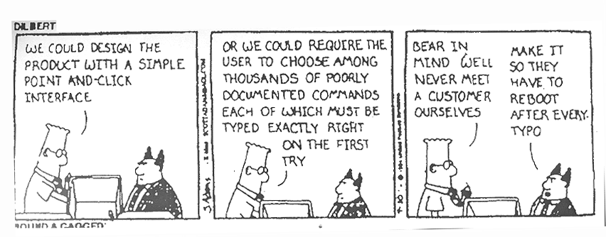
Why?
Without good UI, everything is difficult.
Image found at http://www.vincentchu.com/image/dilbert_interface.gif

Slide 37
How?
GUI
CLI
Graphical User Interface
Most likely to be used on the ground station. Though may also be used on the companion computer.
Command Line Interface
Most likely to be used on the companion computer.

Slide 38
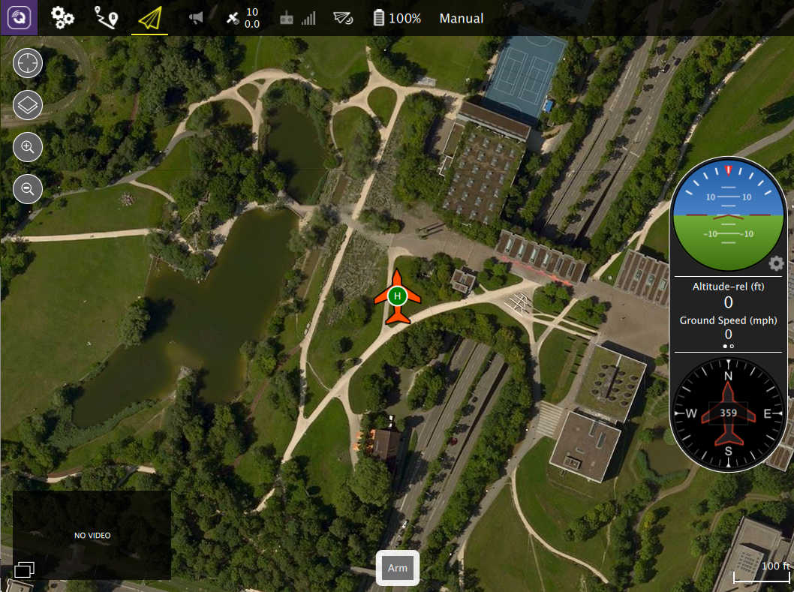
QGroundControl
Nice GUI for setting waypoints and seeing vehicle information.
Can be used with different software packages.
Image from https://donlakeflyer.gitbooks.io/qgroundcontrol-user-guide/content/QuickStart/ConnectedVehicle.jpg

Slide 39
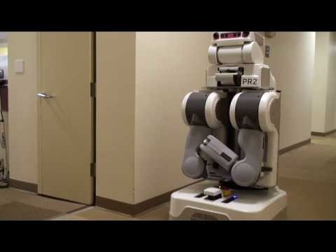
ROS
Robotics Operating System
A generic robotic platform for writing robotic software (www.ros.org).
Has many tools and libraries to pull from.
Is open source and freely available.

Slide 40
User Interface
Dilemma
Things Involved
There is no UI that is a complete package for our purposes.
QGroundControl works with many different drone platforms, but is not used with ROS.
Communication protocols such as MAVLink or the ROS node protocol need to either be compatible with our software, or be easily converted.

Slide 41
Motion Model
How to control the vehicle

Slide 42
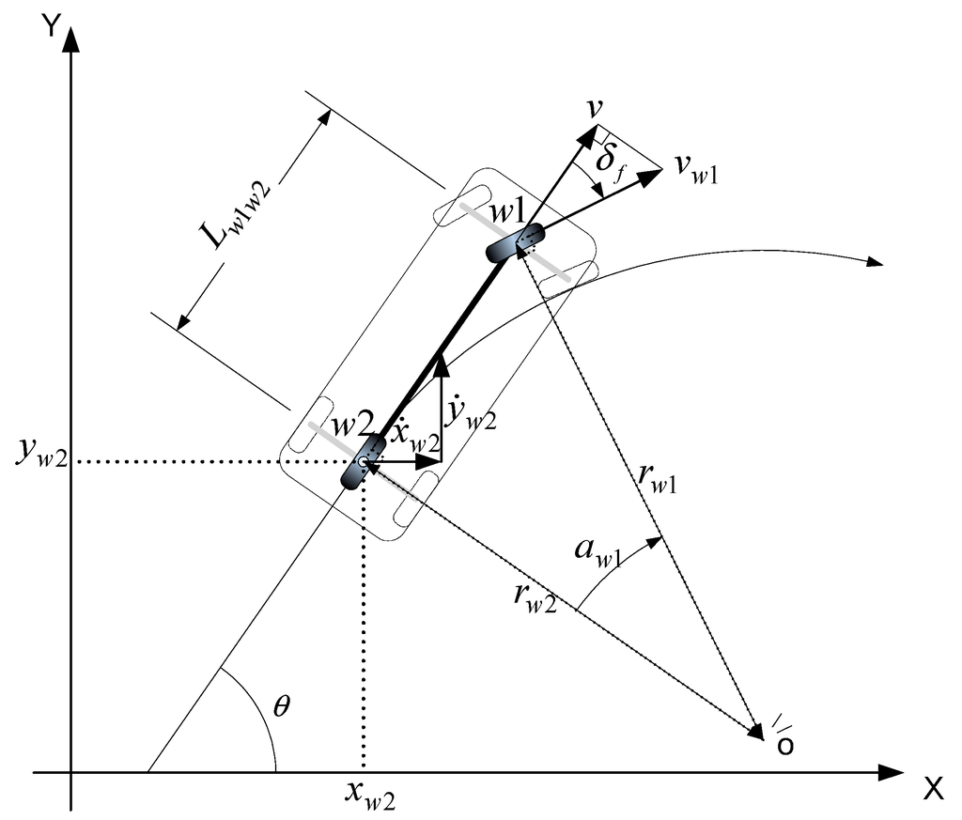
Why?
Determine the fundamental behavior of the car.
Determine the limitations of what the car can do.
A good motion model can reduce uncertainties.
Figure 1
Figure 1: http://www.mdpi.com/1424-8220/15/11/28807/htm

Slide 43
How?
Experiment
Dilemma
Things involved
Not sure if this is necessary.
Depends on how intelligent our system is.
Motor
Servos
Notes:
Depends on how intelligent our system is: like a human driving a car doesn’t need to understand the steering ratio of the car. If the turning angle is too small, a human would just apply more steering. That requires a more sophisticated system.

Slide 44
Control Model
How to have the vehicle strictly follow a path

Slide 45
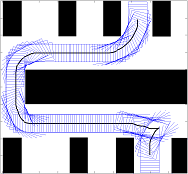
Why?
We want the vehicle to follow a pre-plan path.
But:
They go off paths even on smooth surface.
On bumpy surface, going off path is inevitable.
Figure 2
Figure 2: http://www.cs.cmu.edu/~maxim/ground.html

Slide 46
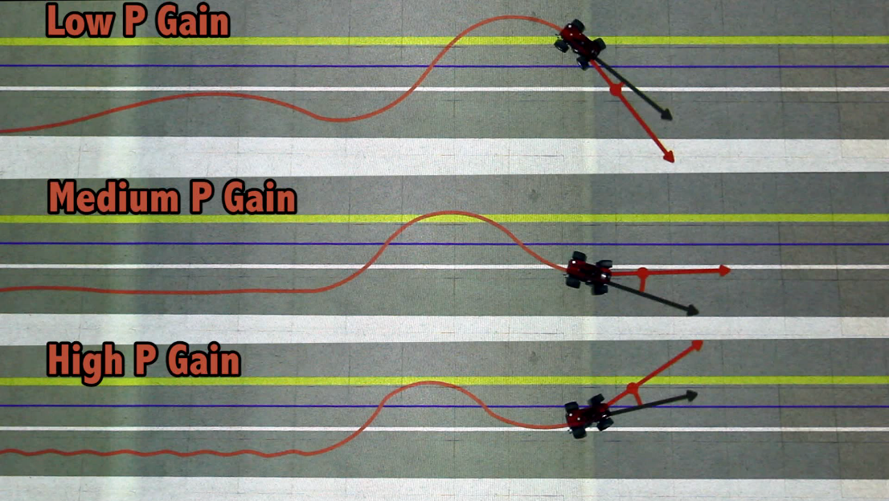
How?
PID Controller
Dilemma
Figure 3
TODO
Still don’t quite understand how it works
Understand the theory
Customize it so that we can use it on our system.
Figure 3: http://www.mit.edu/~jhow/

Slide 47
Local Path Planning
How to get from point A to point B in a local setup

Slide 48
Why?
Makes things easier
Notes:
Local setup: A close environment with predefined boundaries. The environment can be known and unknown. In a known environment, the system has full information of its surroundings. In a unknown environment, the robot has to scan for potential obstacles.
Local navigation is much easies than global navigation intuitively. So we think if we do local navigation first, it will be much easier for us to do global navigation later on.

Slide 49
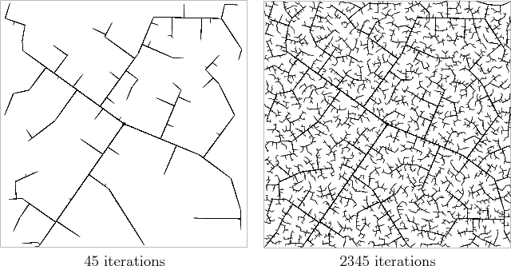
How?
Rapidly-Exploring Random Trees
Perfect for small setups.
Fast and reliable
Easy to implement
Figure 4
Figure 4: http://planning.cs.uiuc.edu/node231.html
Notes:
Rapidly-Exploring Random trees randomly generate samples from valid space (not inside obstacles or outside the map) and attempts to make connections between samples. Connections must pass through free space and be straight. Eventual, it will produce a graph that contains both the goal node and start node.

Slide 50
Global Path Planning
How to get from point A to point B in a global setup

Slide 51
Why?
It’s a autonomous Vehicle

Slide 52
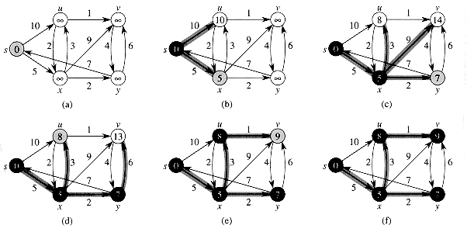
How?
A-Star-based Dijkstra’s Algorithm
Classic path planning algorithm with edge costs
Fast and reliable with A star
Easy to implement
Figure 4
Figure 4: http://staff.ustc.edu.cn/~csli/graduate/algorithms/book6/chap25.htm
Notes:
With the help of GPS and satellite map, we can generate waypoints on the map. We then use this algorithm to find the shortest path. The local path planning algorithm will take care of the rest.

Slide 53
Special Algorithms
Drifting and Parallel Parking

Slide 54
Why?
Cool && Challenging
Notes:
We like cool stuff and challenges. It would be much better if we are the ones who do the cool stuff.

Slide 55
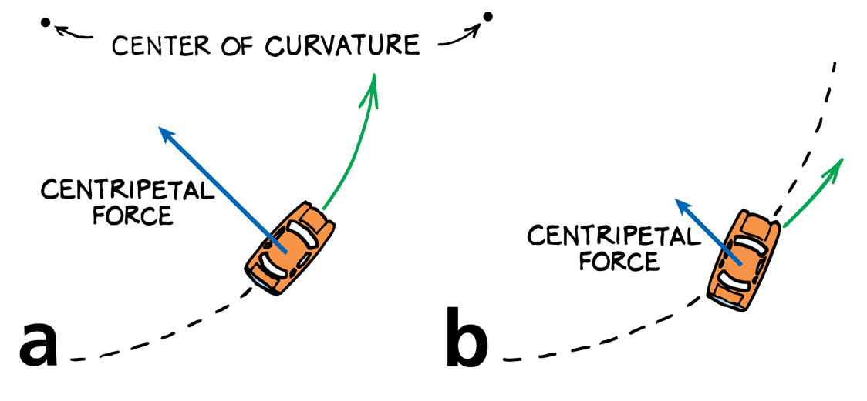
Drifting: How?
Special Motion Control
Center of Gravity
Speed and planning
Uncertainties and safety.
Figure 5
Figure 5: https://kaiserscience.wordpress.com/physics/kinematics/acceleration/
Notes:
It is hard to predict the path when the vehicle is drifting. We need a solid motion and control model to tackle this task. Safety is our next digest concern, because drifting requires high speed or angular momentum.

Slide 56
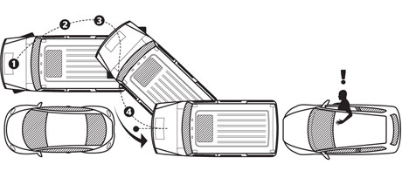
Parallel Parking: How?
Special Path:
A special pre-defined path
Real-time or static
Figure 6
Figure 6: http://www.esquire.com/lifestyle/cars/a5830/parallel-parking-tips-0509/

Slide 57
Vision System
I can see clearly now my eyes are plugged in
I can see all obstacles in my way
Gone are the dark clouds that had me blind

Slide 58
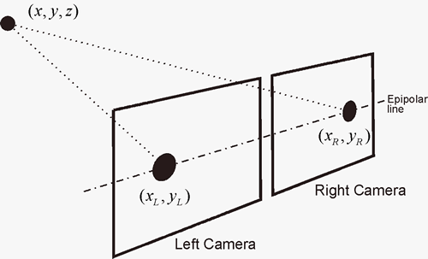
Why Stereo Vision?
Can be used in direct sunlight
Similar to how our eyes work
Can be processed into a point cloud
Inexpensive Hardware
Adjustable Field of View

Slide 59
System Interfaces
Wait… How does that work?

Slide 60
Hardware Layout
All processing is done on the Main Computer
Raspberry Pi is required for the PXFmini
PXFmini handles motor and Servo Control
PXFmini sends sensor data through Raspberry Pi to the main Computer

Slide 61
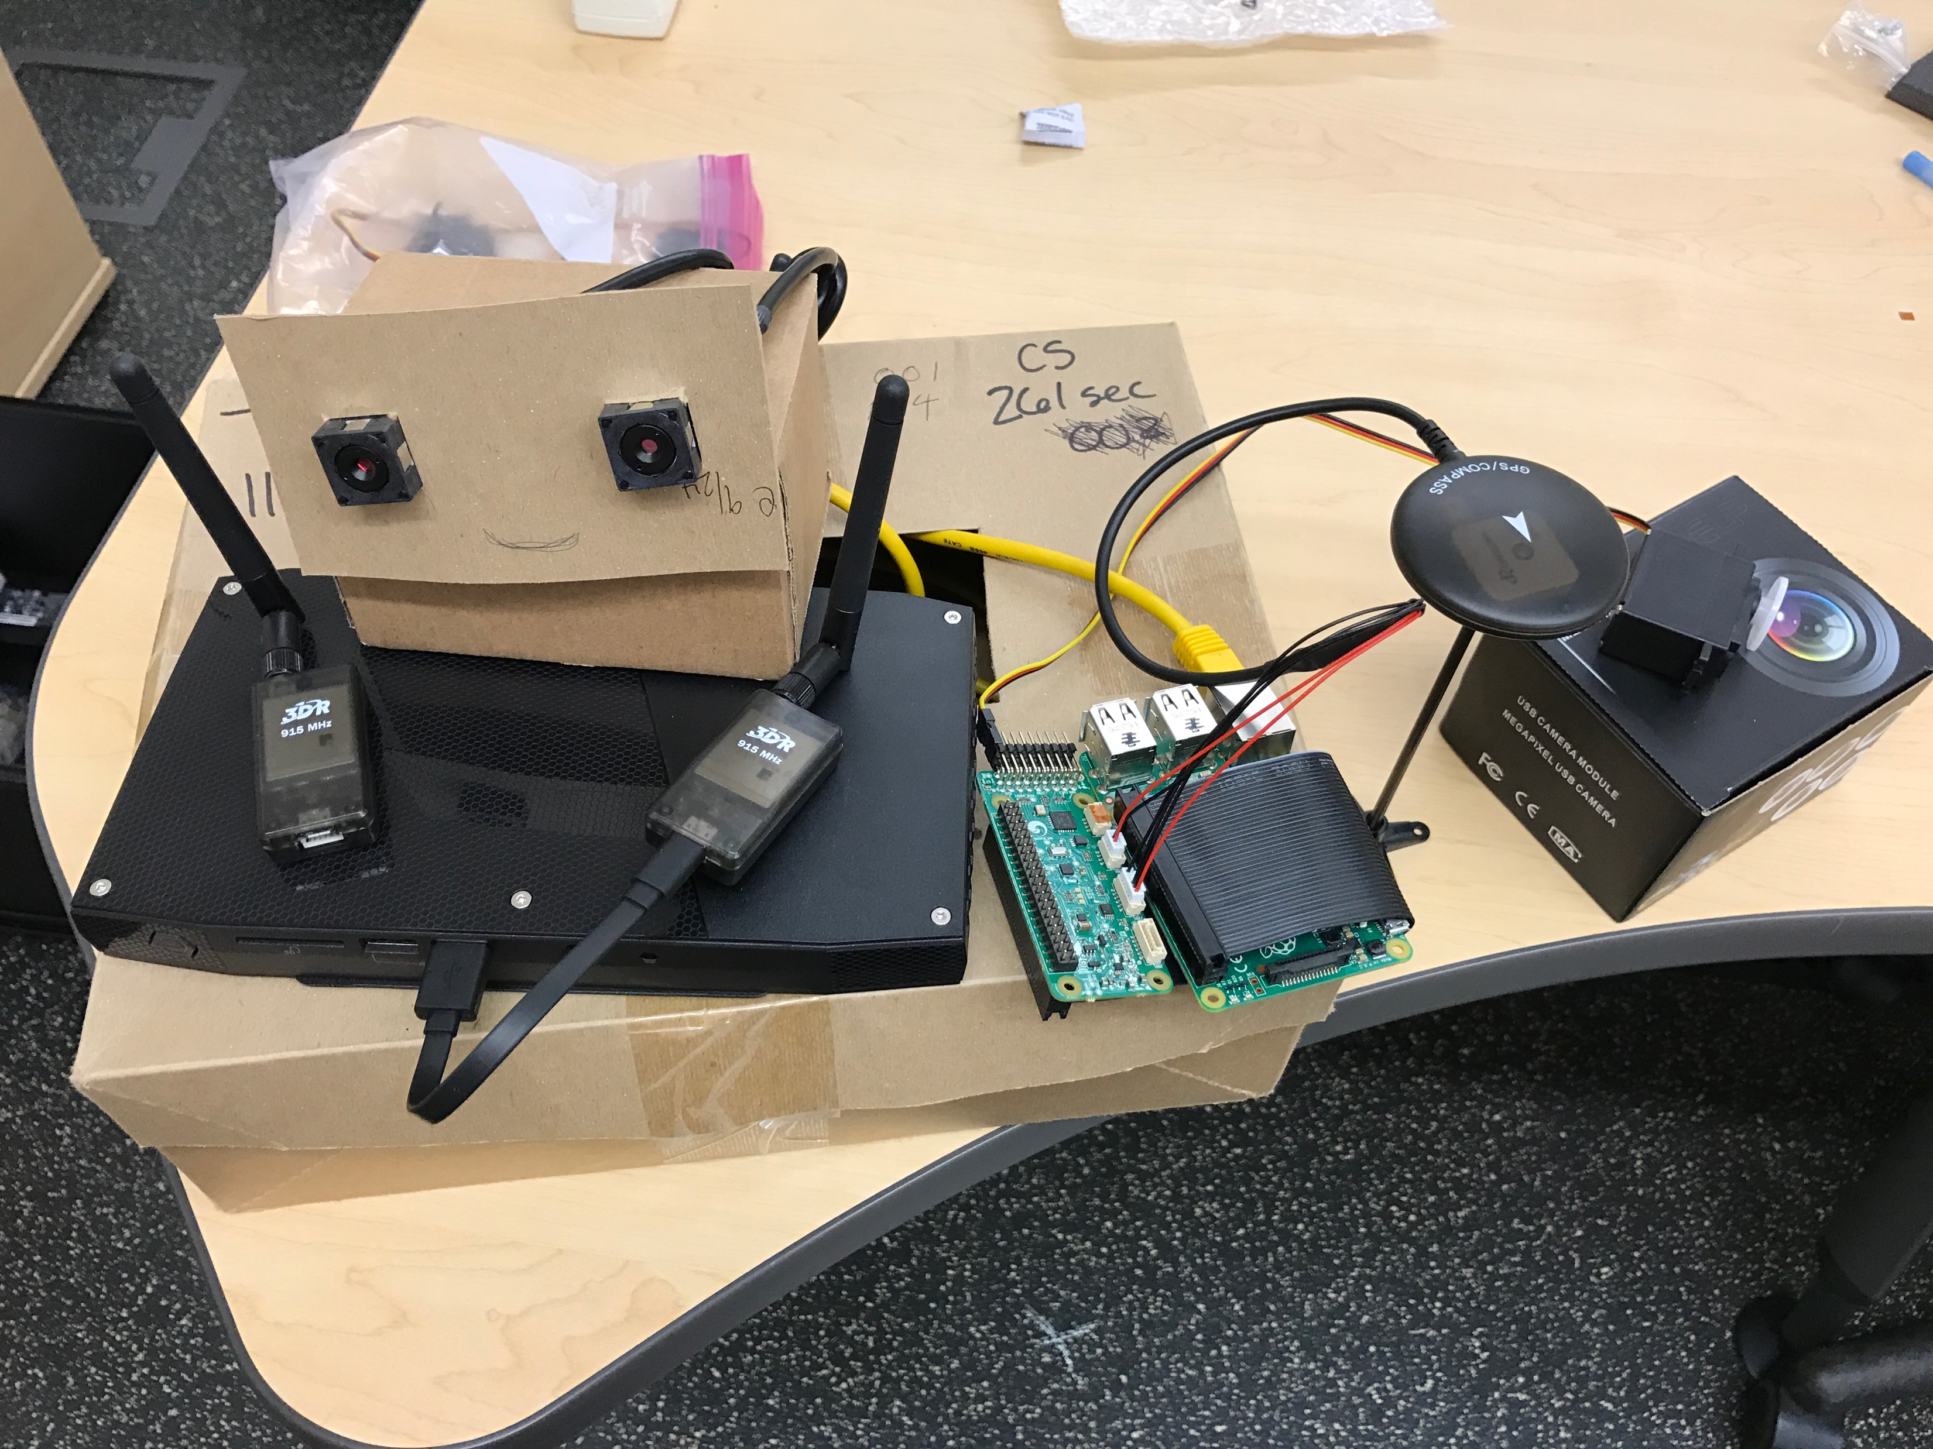
Hardware Being Used
Intel NUC
3DR 915Hz Radio (x 2)
Two USB cameras
GPS with Compass
Raspberry Pi
PXFmini

Slide 62
Conclusion
Summary of good things that have happened.
Summary of changes that need to be made and what we will do to make the changes.
Next term we will be implementing our experimental design process. This will be an iterative process where we try our initial design elements, test the results against our requirements, and make adjustments based on the results. We will gradually increase the capabilities of the vehicle as we meet our milestones.

